Slide 1
Milwaukee PCC
P.O. Box 1761
Milwaukee, WI 53201-1761
FIRST-CLASS MAIL
Postage & Fees
PAID
USPS
PERMIT NO.
G-10
We're refreshing
our membership list
Be the BEST that
YOU Can Be
In 2023
Please confirm your contact
information today and
Get Connected and Grow!

Slide 2
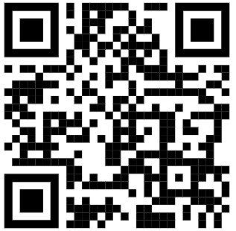
Please email Shearon at
Shearon.A.Smith@usps.gov
and confirm the following information:
Need to update
your membership
information?
Name, Title
Know someone who could benefit from
PCC membership?
Company Name
We look forward
to Networking with You soon!
Mailing Address
Just tell Shearon
or
Send them the link!
Email
Phone no.
Get Connected and Grow
Scan and Join Today!
www.milwaukeepcc.com

